Slide 1
Prototype

Slide 2
What is?
Copy existing objects
Cloning (duplicate) of an existing object instead of creating new one

Slide 3
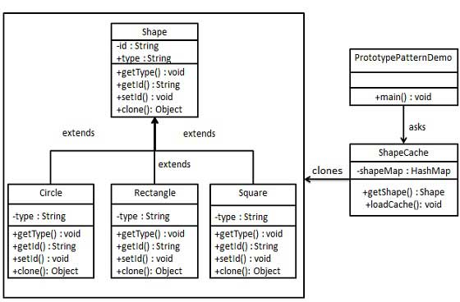
Implementation

